Slide 1
Final project CORE MICROPROBE ANALYSIS made by Elizaveta Gladchenko and Ramilya Sharifullina

Slide 2
Why is it important (education)?
Porosity is one of the key parameters of reservoir rock that should be identified for calculation of the amount of oil or gas that can be found in the field and then obtained by different production techniques. Besides, not only the value of porosity that matters.
What's the expected value of our CV algorithm?
Identification of tiny pore spaces between grains of the rock, estimation of their form and type of porosity in the sample

Slide 3
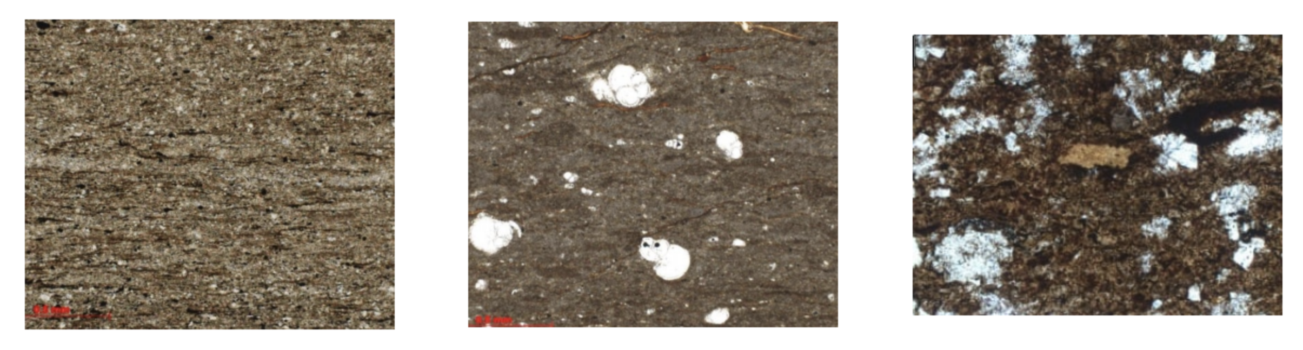
Dataset description
Microprobes of reservoir rock samples and real values of porosity

Slide 4
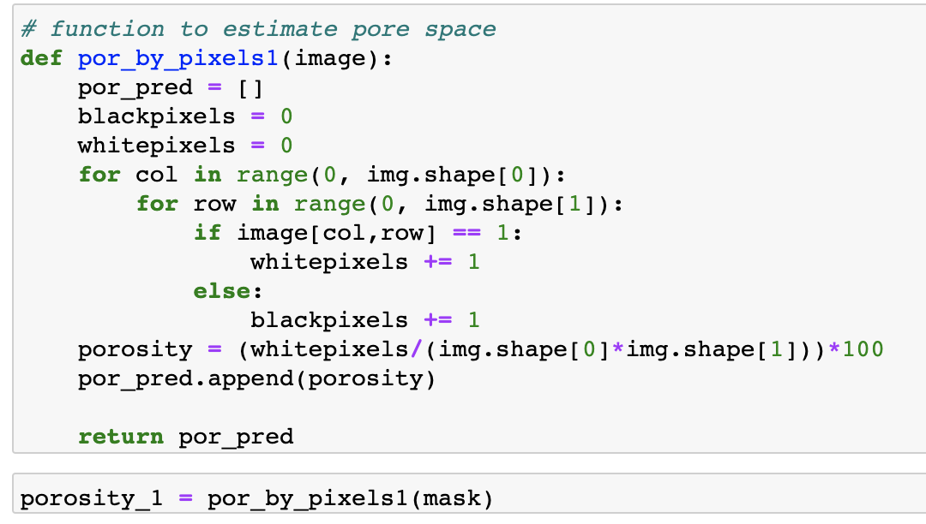
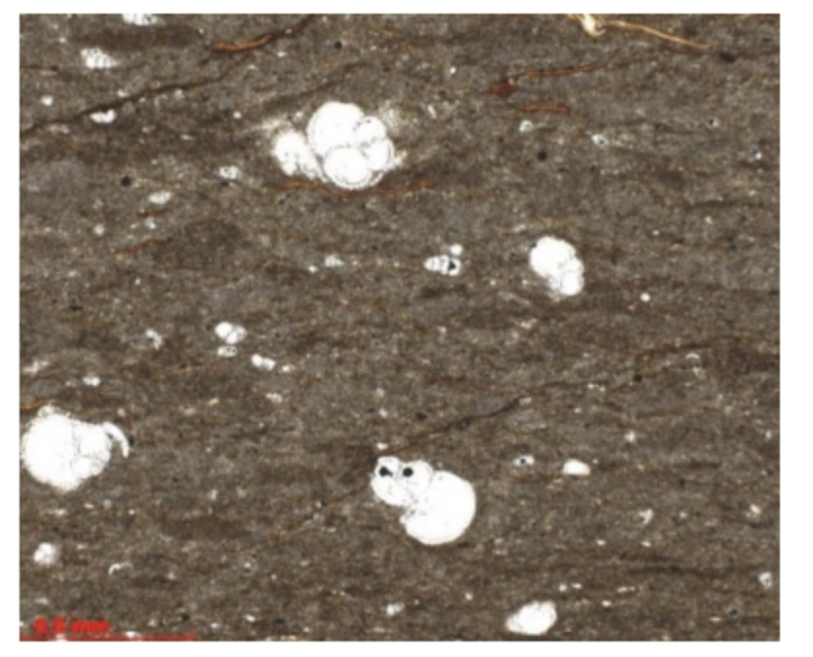
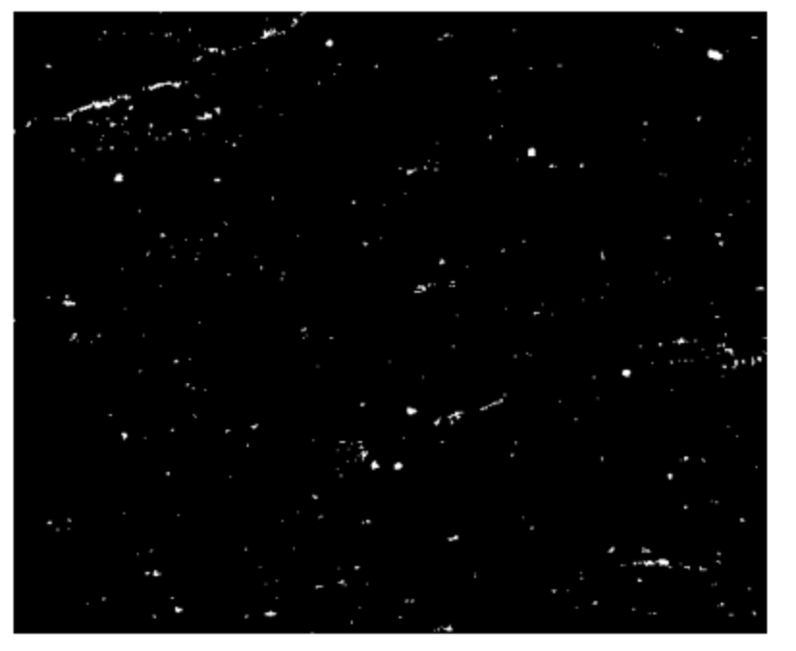
The first method – mask by “hsv” + calculate by pixels
Step 1 - original image
Step 2 – create the mask
Step 3 – calculating the pore space

Slide 5
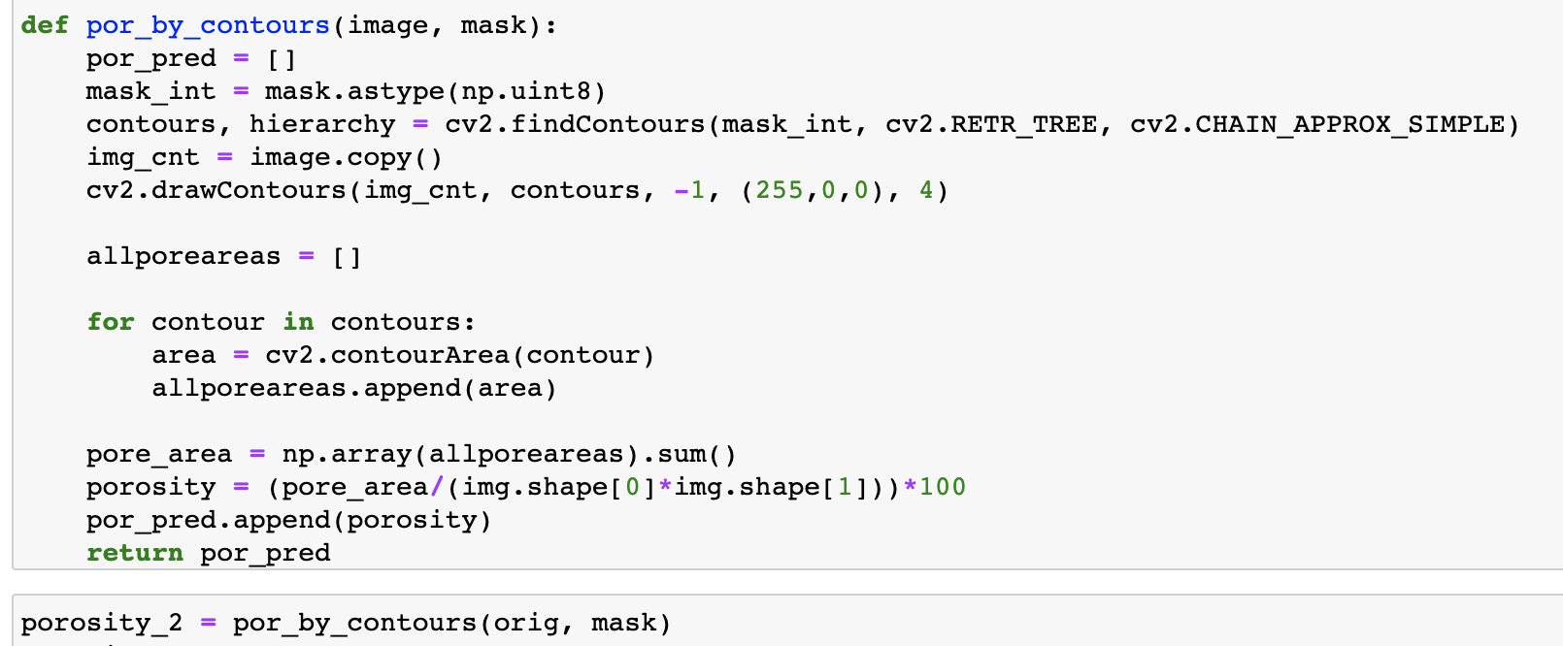
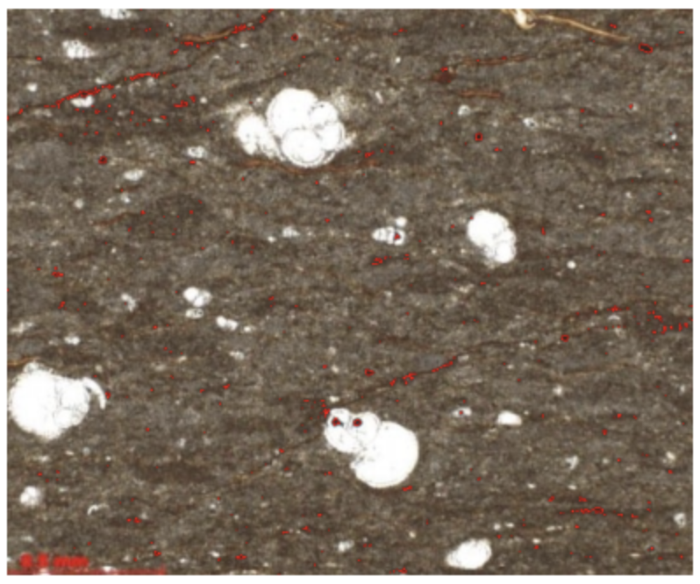
The second method – mask by “hsv” + contours
Step 1 - original image
Step 2 – contours
Step 3 – calculating the pore space

Slide 6
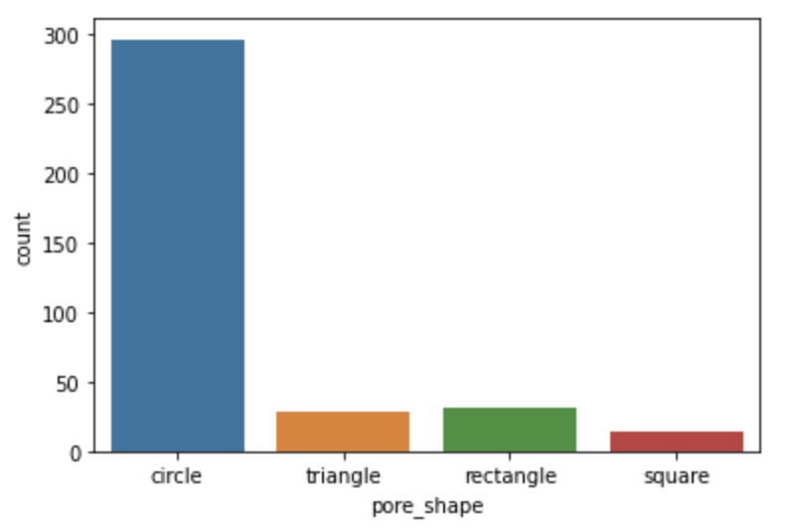
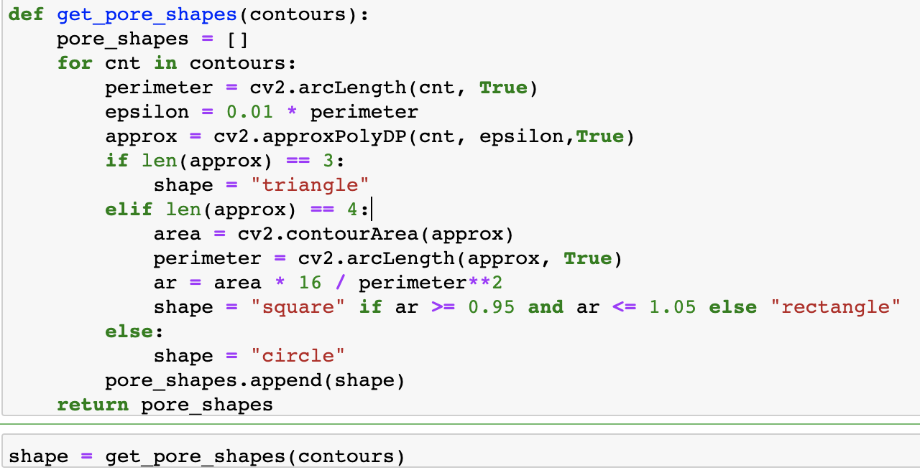
The second method – pore type
Figure – count plot from seaborn

Slide 7
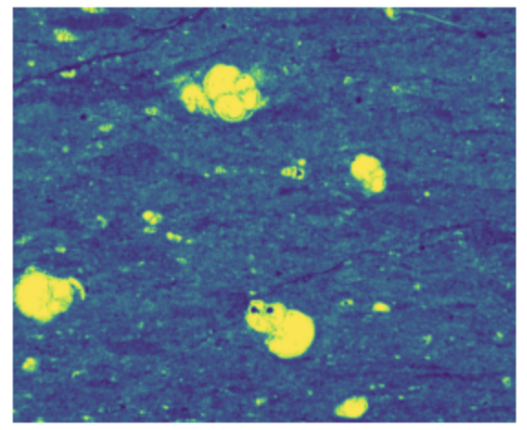
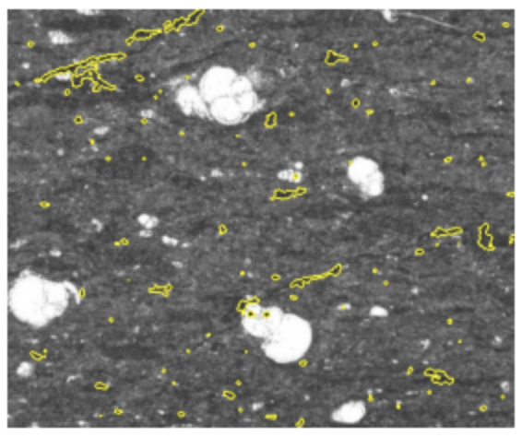
The third method – segmentation
Step 4 – calculation pore space (like in the first method)
Step 1 - original image
Step 2 – markers
Step 3 – segmentation

Slide 8
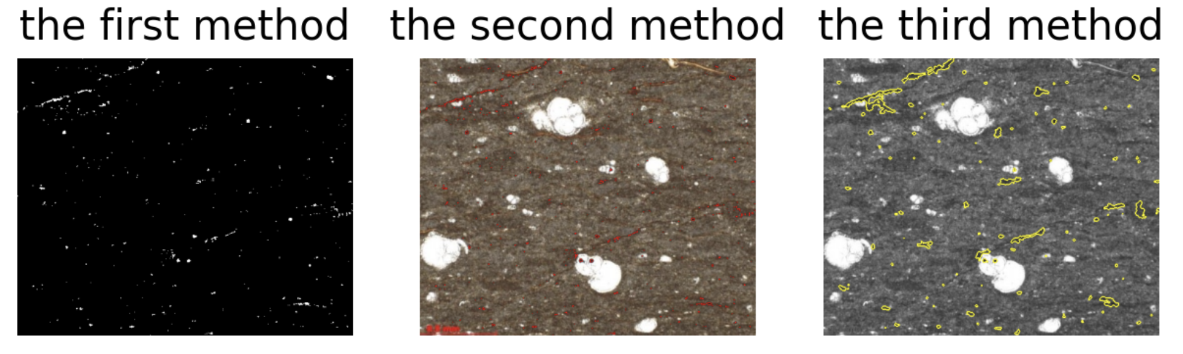
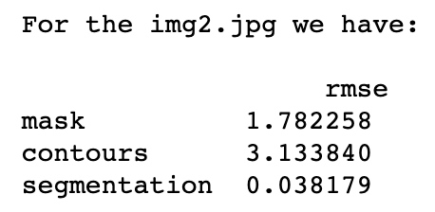
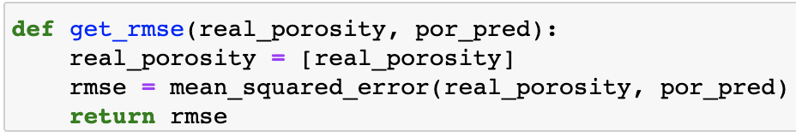
Estimate quality metrics (“rmse”) and comparing
Code for “rmse”
Results

Slide 9
CV pipeline suitable to solve the problem – pipeline with contours detection
good results
extra useful information
Motivation for each step of the pipeline
hsv color space – clear pore spaces
the mask - more precise contours
contours - calculation of the area of pores
approximating contours of pores, dividing them into different shapes and getting the most common one - type of porosity

Slide 10
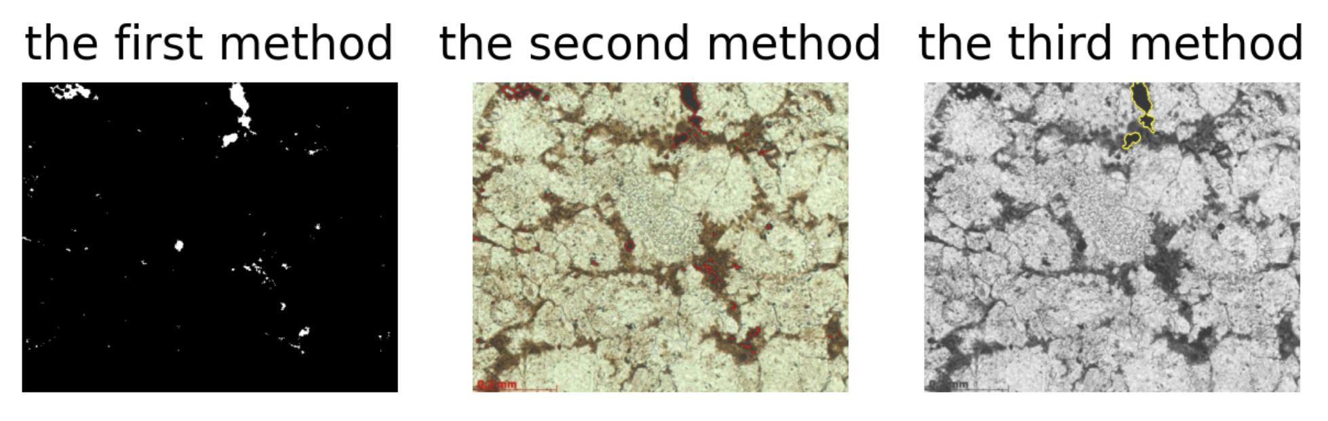
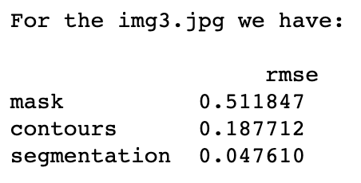
The same for another image – good one

Slide 11
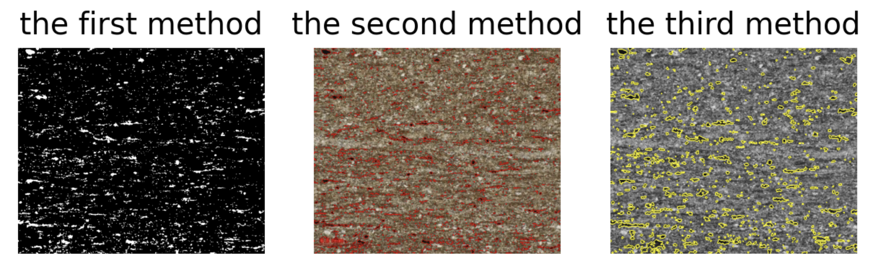
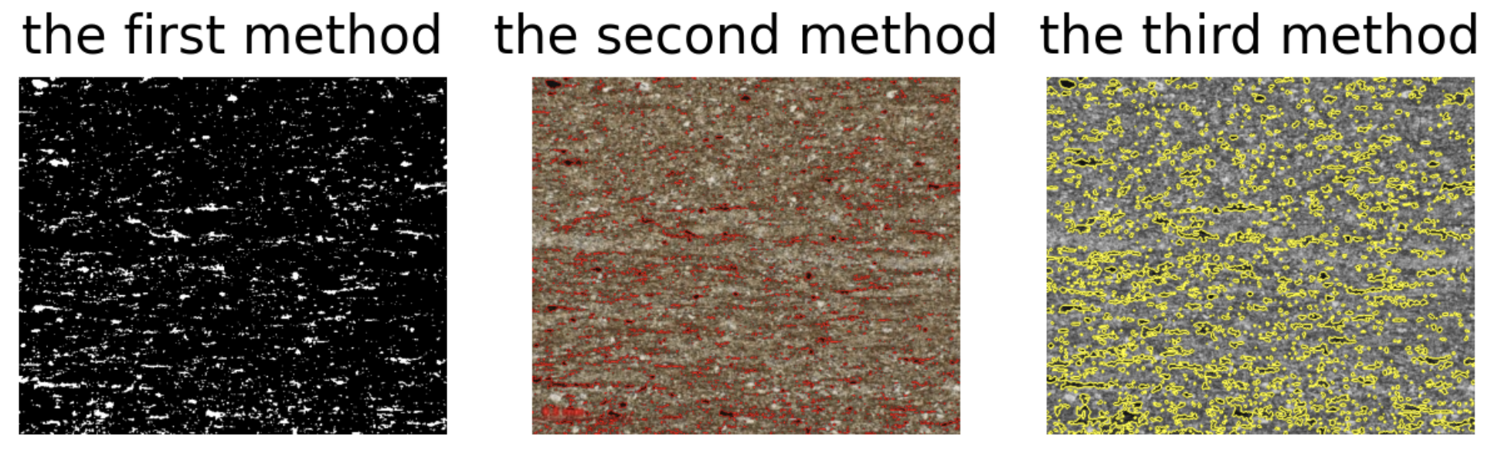
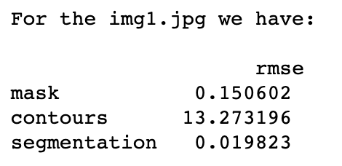
Bad example

Slide 12
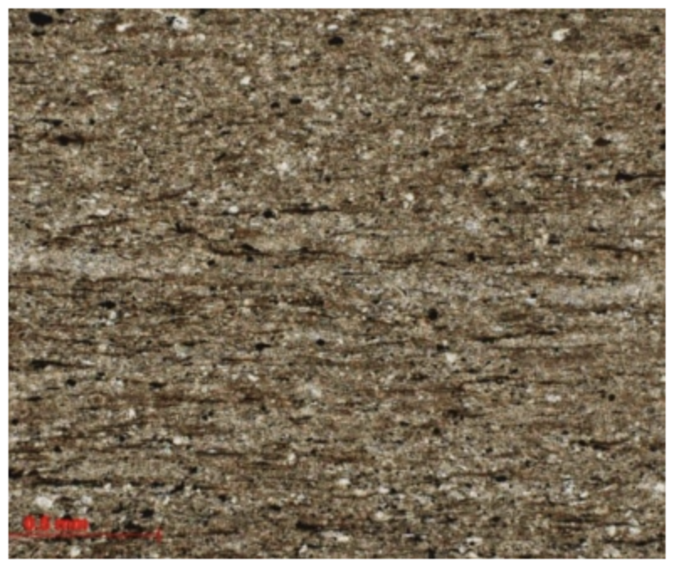
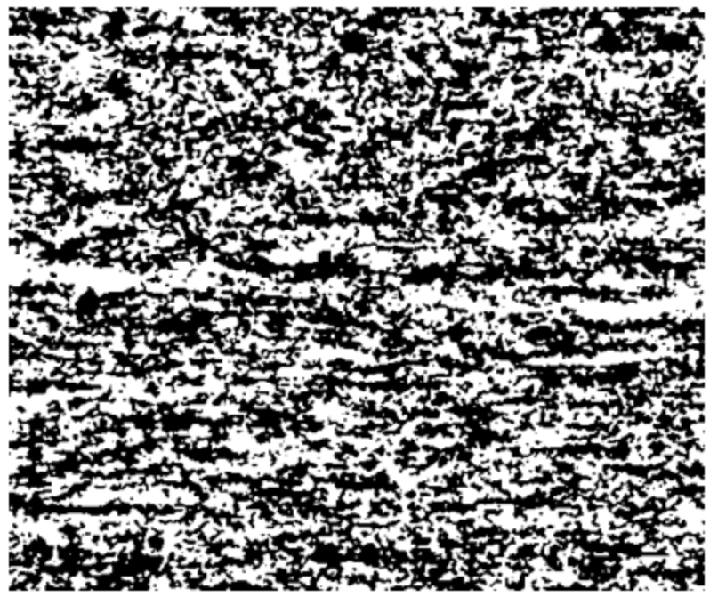
What else we have tried
2. Working with images in gray colored space
1. CNN
original image
result

